Slide 1
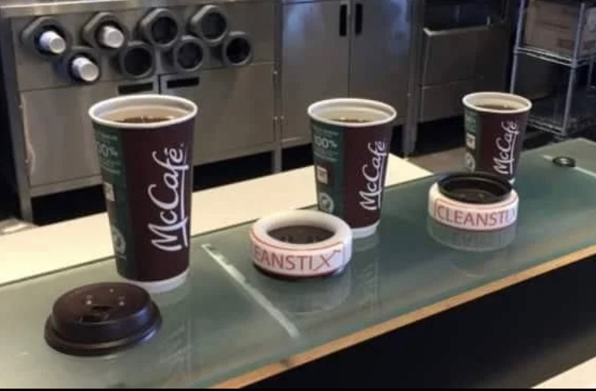

Cleanstix As A Covid Safe Lid Applicator
By Chigozirim Kelvin Igwe
215410848
HLST 4340

Slide 2
Table Of Contents
Introduction
COVID-19 Pandemic
COVID-19 Complications
Clearstix/Clearcap As Covid Safe Lid Applicator
Aim Of Presentation
Evaluating Impact Of Clear Cap
Clinical Analysis
Model Case Prediction
Economic Analysis
Ethical And Political Implications
Key Findings
Conclusions

Slide 3
Introduction
COVID-19 Pandemic
Healthcare systems in Canada within the province of Ontario specifically are on the brink of collapse due to increased demand for patient care and complications arising from the virus
Ontario is also dealing with equipment and personnel shortages such as PPE and respiratory therapists
This technology has the potential to reduce infection/reinfection rates significantly, reducing the strain on the health system while saving lives through prevention

Slide 4
Introduction Continued
COVID-19
Can be described as an communicable illness caused by the SARS-COV 2 virus from the Coronavirus family
This virus majorly attacks the respiratory system pathways causing difficulty in breathing in patients
Transmitted via airborne droplets
Illnesses severity can range from mild to critical

Slide 5
Introduction Continued
COVID-19 Complexities
The coronavirus can be contracted and passed by anyone within a population who interacts with an infected carrier
However not much is know as to why the virus is fatal or life threatening requiring intubation for some individuals while non fatal/mild for others.
Most Affected Populations
Not all communities were equally affected by Covid-19
Some communities exposed to most of the harm due to the inherent vulnerabilities created by social arrangements and agreements between governments and corporate entities

Slide 6
Introduction Continued
COVID-19 Complexities
Communities severely affected by the virus includes;
Seniors living in care homes
Seniors.i.e individuals above 60
Incarcerated individuals
Individuals with comorbidities
Individuals who are immunocompromised
Individuals living with obesity
Individuals with chronic medical conditions.
Individuals of low income

Slide 7
Introduction: Clearstix/Clearcap As Covid Safe Lid Applicator.
Name Of Intervention: Covid Safe Lid Applicator called the “CLEAR CAP/CLEARSTIX”
Structure And Material: Clearcap is a simple ring, produced from medical grade plastic.
Outcome: Clearcap prevents the transmission of this virus from workers (employees) to the customers.
Process Description: The Clearcap enables the application of lids to cups of beverages without workers having physical contact with the lids. This was a previously major transmission point for new COVID-19 infections and reinfections as workers were at a higher risk for contracting COVID-19.
Target Population: This health intervention could be utilized by anyone in both commercial and private environments/settings, although it is primarily marketed towards companies in service industries that prepare/serve beverages to consumers. Example; Starbucks, Tim Hortons.

Slide 8
Aim Of Presentation
The goals of this presentation includes the following;
Informing Canadian policy makers, business owners, insurance companies, hospitals, and key industry players with information about the Covid safe lid applicator mechanism.
To encourage the adoption of Covid safe lid applicators in relevant industries by providing scientifically backed evidence.
The adoption of covid safe lid applicators would assist in combating infection/reinfection rates across Canada reducing the strain on the public health systems.
Ensuring the covid safe lid applicator is appropriate for commercial and domestic use within Canada.

Slide 9
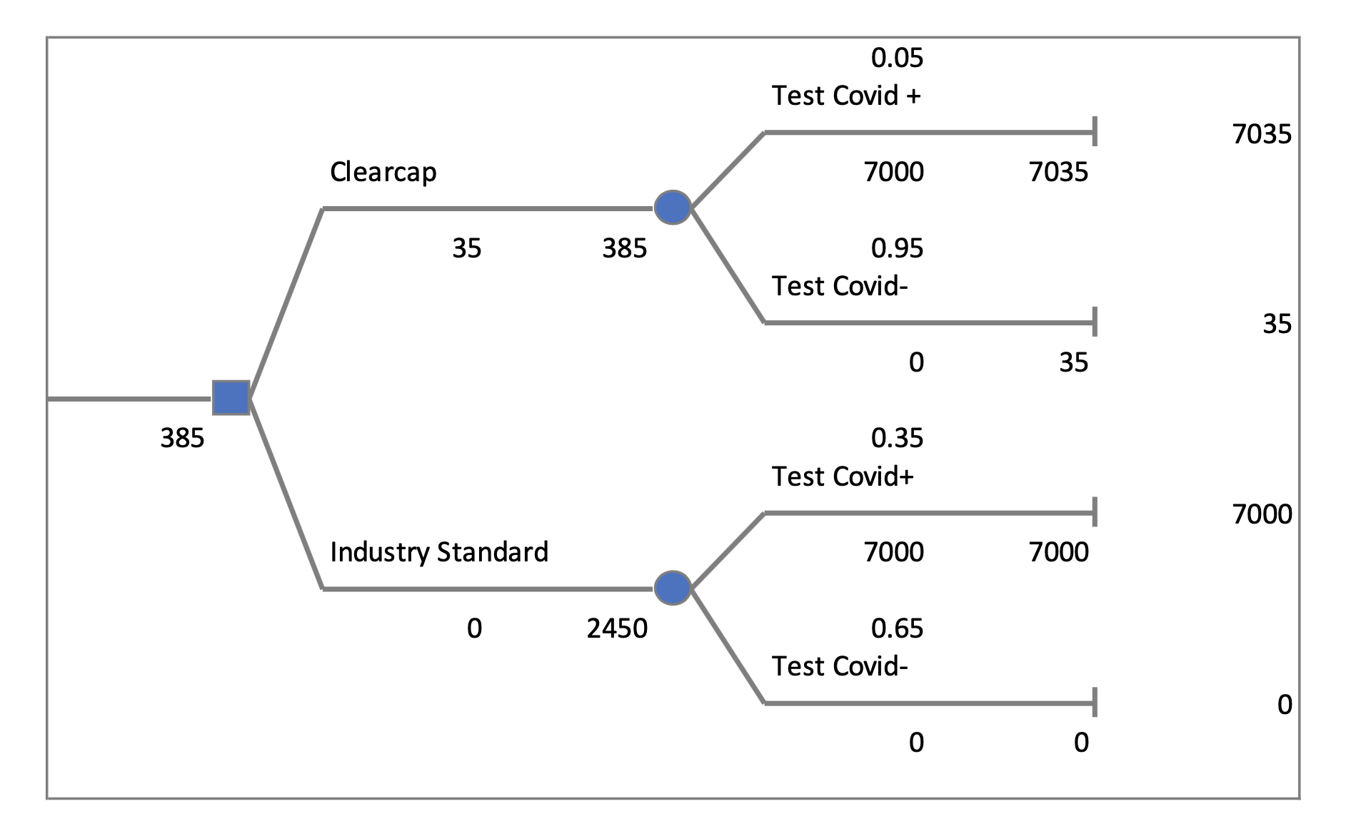
Evaluating The Impact Of Clear Cap Using Decision Trees

Slide 10
Evaluating The Clinical Impact Of Clearcap
Decision Tree modelling was employed for both cost utility analysis and simulated case modeling with two actionable options, along with their possible consequences and likelihood/probability of occuring.
Actionable options include:
1) Decide to purchase and use Clear cap
2) Continue with Industry standard
Possible Outcomes for both options:
1) Test positive for Covid 19
2) Test Negative for Covid 19

Slide 11
Evaluating The Clinical Impact Of Clearcap Continued
Currently, industry standard which is wearing masks reduces the probability of catching the virus by 0.65.
1QALY is gained for every case of the virus prevented. i.e., tests negative
1QALY is lost for every case of the virus. i.e., tests positive
The new intervention reduces the probability of catching the virus to 0.95.
N=100 participants, were assigned to each option to aid in modeling the outcomes and costs associated with both options.
The cost of care for an individual admitted by a Health Centre per night is projected to be $7000 source CIHI.

Slide 12
Model Case Predictions
Model of Case predictions using clear cap vs industry standards with 100 individuals assigned to each option
Clear cap (intervention) |  | Industry Standard
COVID 19 positive | COVID 19 Negative | COVID 19 positive | COVID 19 Negative
5 | 95 | 35 | 65 | Total (no. of cases)

Slide 13
Evaluating The Clinical Impact Of Clearcap (QALY’s)
Projected gains and losses of QALY’s associated with each option
Clear cap (intervention) |  | Industry Standard
COVID 19 Positive | COVID 19 Negative | COVID 19 Positive | COVID 19 Negative
5*(-1) | 95*(1) | 35*(-1) | 65*(1) | Num of cases*cost of care
5 QALY’s lost | 95 QALY’s gained | 35 QALY’s lost | 65 QALY’s gained | Total Cost

Slide 14
Evaluating The Economic Impact
Costs incurred to the provincial health budget
Clear cap (intervention) |  | Industry Standard
COVID 19 Positive | COVID 19 Negative | COVID 19 Positive | COVID 19 Negative
5*7000 | 95 | 35*7000 | 65 | Num of cases*total cost of care
$35000 | 0 | $245000 | 0 | Total Cost

Slide 15
Evaluating the Political Impact of Clearcap
This intervention has the ability to prevent transmission of covid-19 from a previous hotspot for infections and, thus it’s benefits have a wide range
This intervention through curbing infection rates has the potential to ease the burden on the public health system
This intervention raises the bar for industry practice and standards if adopted as it also prevents transmission of other communicable airborne diseases such as influenza, rotavirus, ebola
This intervention can save Canadian governments and public health systems millions in taxpayer dollars that would otherwise have been spent managing and treating Covid-19 patients

Slide 16
Key Findings
Deciding to adopt the Clear cap intervention would cost $35 as an initial investment to purchase product.
The Clear cap would then incur an additional cost of $35000 per night at health center's for every 100 individuals served by franchise to the provincial healthcare budget($350 per individual).
In other words, for every 100 individuals served 5 individuals are likely to contract the virus. However, adhering to Industry standards would incur a cost of $245000 per night at health centres for every 100 individuals served, in other words 35 people get sick ($2450 per person).
Adopting the Clear Cap health technology would save provincial Canadian Health systems $210,000 per day for every 100 individuals served, saving $2065 per individual.

Slide 17
Concluding Remarks
In conclusion this report recommends the adoption of the Covid-19 safe lid applicator intervention called Clearcap
This intervention would save thousands of tax dollars which would have otherwise been spent on treatment costs if adopted province wide within Ontario
This intervention would also assist in reducing infection rates of Covid-19 across beverage serving industries by preventing client to customer transactions

Slide 18
References
Rizwan K, Rasheed T, Khan SA, Bilal M & Mahmood T. (2020). Current perspective on diagnosis, epidemiological assessment, prevention strategies, and potential therapeutic interventions for severe acute respiratory infections caused by 2019 novel coronavirus (SARS-CoV-2). Human vaccines & Immunotherapeutics, 16, 3001-3010. https://doi.org/10.1080/21645515.2020.1794684, 10.1080/21645515.2020.1794684 https://www-tandfonline-com.ezproxy.library.yorku.ca/doi/full/10.1080/21645515.2020.1794684
Roberts JD & Tehrani SO. (2020). Environments, Behaviors, and Inequalities: Reflecting on the Impacts of the Influenza and Coronavirus Pandemics in the United States. International Journal of Environmental Research & Public Health [Electronic Resource], 17, https://doi.org/10.3390/ijerph17124484, 10.3390/ijerph17124484 https://www.mdpi.com/1660-4601/17/12/4484
Elrashdy F, Redwan EM & Uversky VN. (2020). Why COVID-19 Transmission Is More Efficient and Aggressive Than Viral Transmission in Previous Coronavirus Epidemics?. Biomolecules, 10, https://doi.org/10.3390/biom10091312, 10.3390/biom10091312 https://www.mdpi.com/2218-273X/10/9/1312

Slide 19
References
Yyc Times (2021). Father-son team allege Tim Hortons took their COVID-safe lid applicator idea. Retrieved from https://yyctimes.ca/index.php/2021/01/11/father-son-team-allege-tim-hortons-took-their-covid-safe-lid-applicator-idea/
Kushman, R.(2020). Your Mask Cuts Own Risk by 65 Percent Retrieved from https://www.ucdavis.edu/coronavirus/news/your-mask-cuts-own-risk-65-percent/
Marchand-Senecal X, Kozak R, Mubareka S, Salt N, Gubbay JB, Eshaghi A, et al. (2020). Diagnosis and Management of First Case of COVID-19 in Canada: Lessons Applied From SARS-CoV-1. Clinical Infectious Diseases, 71, 2207-2210. https://doi.org/10.1093/cid/ciaa227, 10.1093/cid/ciaa227 https://academic-oup-com.ezproxy.library.yorku.ca/cid/article/71/16/2207/5800047

